Slide 1
Systems Training
Entering a new order

Slide 2
Enter a new Order
Select ‘Order Entry’ from your LoadMaster toolbar

Slide 3
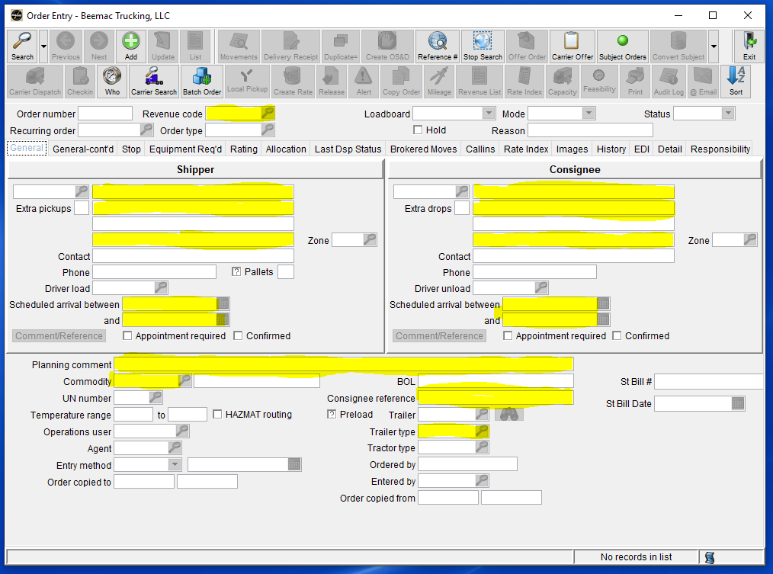
Enter a new Order
Select the Green ‘Add’ button to enable the fields below then enter load information.
Yellow highlighted areas are the minimum required fields

Slide 4
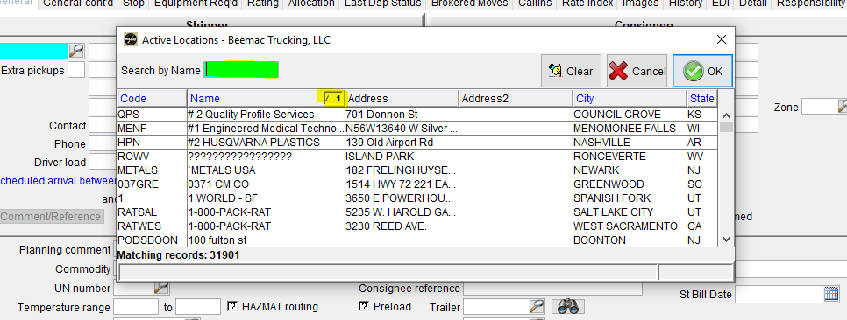
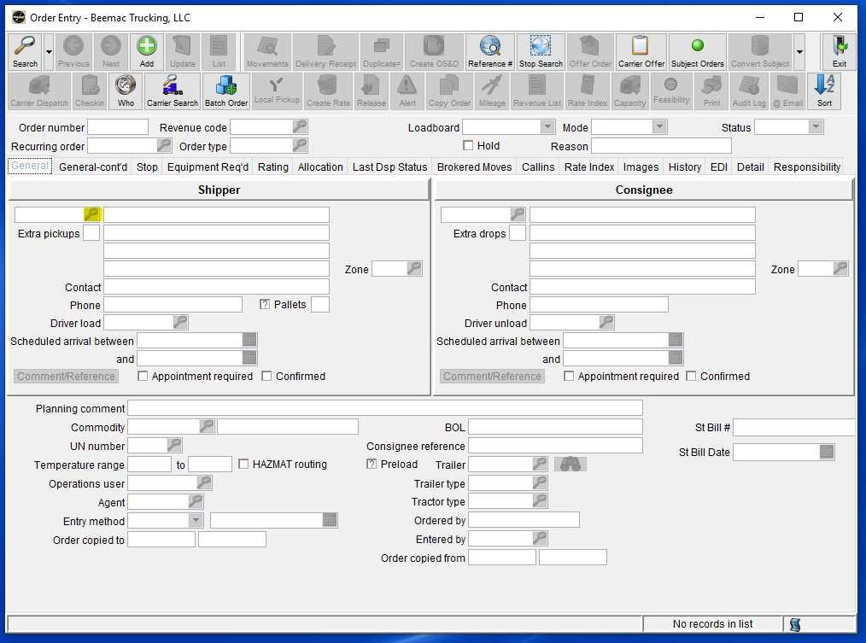
Enter a new Order
To use an existing location select the magnifying glass next to the location code box
You can change the search criteria by clicking on any of the headers to search by that information off the release
A separate window will open called ‘Active Locations.’ You may search the name of any location in the blue search box

Slide 5
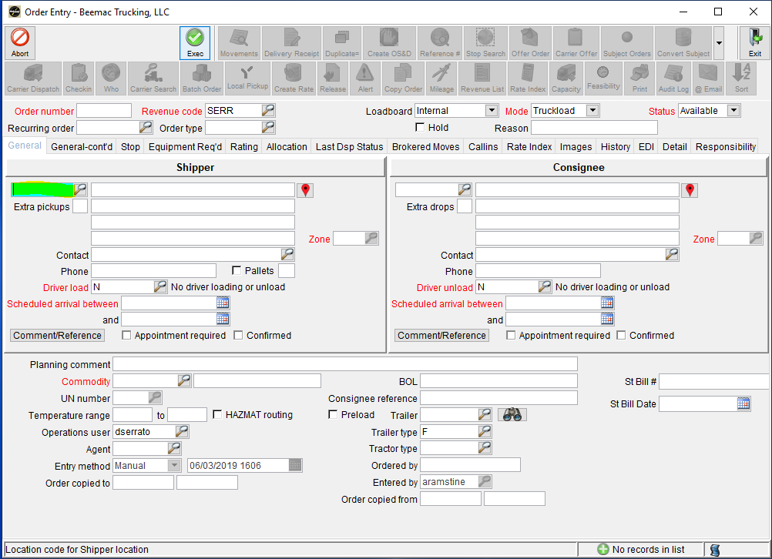
Enter a new location
There are two ways to enter a new location
Select ‘Location’ in your LoadMaster Menu
Right click in the ‘Location Code’ field and select ‘New Location’

Slide 6
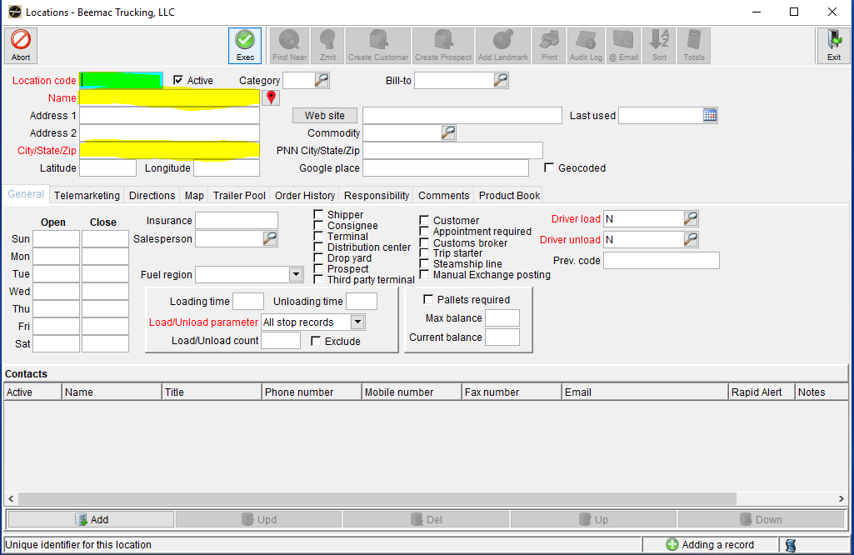
Enter a new location
Once you open the ‘Location’ window you will select the green ‘Add’ button.
Next you will create a location code. (I use the first three letters of the facility name and the state abbreviation.)
After that enter the city and state. You may also enter the contact information. However, keep in mind that this information will populate every time someone in Beemac uses this built location. Not everyone has the same contact at a facility as you.
Once everything is added select ‘Exec’ button to save the location and then exit the screen.

Slide 7
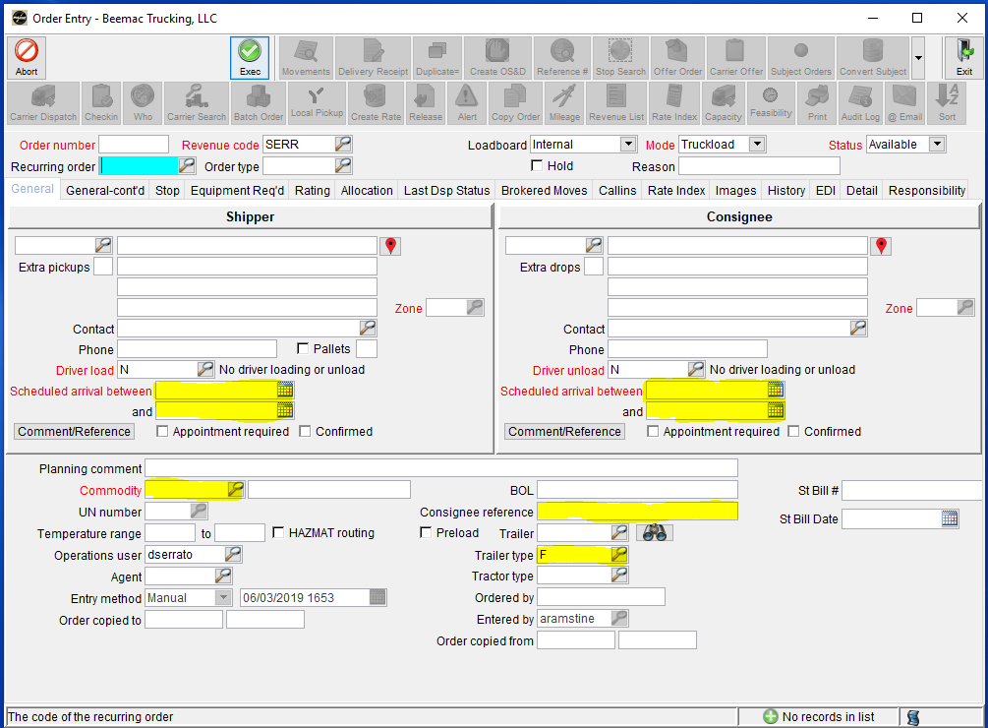
Enter a new ORDER
After entering both the Shipper and the Consignee address you will then add the dates and times. You can enter the dates by typing them manually, using the calendar button, or short cuts. (t – today, t+1 – tomorrow)
In the bottom of the order entry you are required to fill out three fields to build your load… Commodity, Consignee Reference, and Trailer Type.
In the Commodity and Trailer fields you can select the magnifying glass to search all of our built commodities.
In the Consignee Reference field you will be entering the number in which your customer uses to identify the load.
You will also be entering information in the Planning comments later in load building

Slide 8
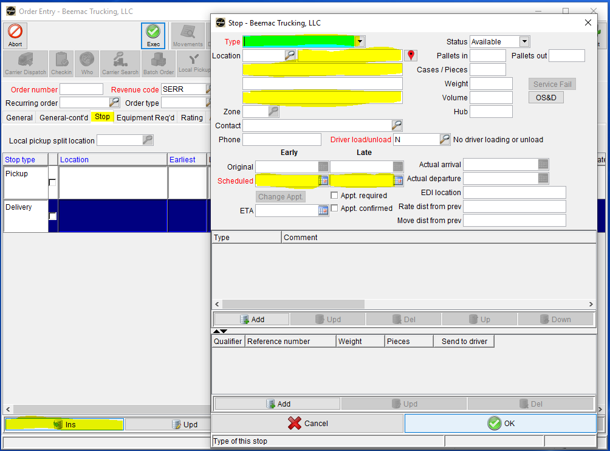
Entering a stop
When building a load with more than one pickup or delivery you will select the ‘Stop’ tab. After that select the pickup or delivery line and select ‘Ins’ at the bottom of the screen. This will prompt a pop-up box.
In the pop-up box you will enter all the same information for the other stops such as facility name, street address, city and state, contact name and phone number and the pick-up and delivery dates and times.
Once your are done select ‘OK’ and your stop will appear in between the pick-up and delivery. You can move the stop order by using the ‘Up’ and ‘Down’ buttons at the bottom of your screen.

Slide 9
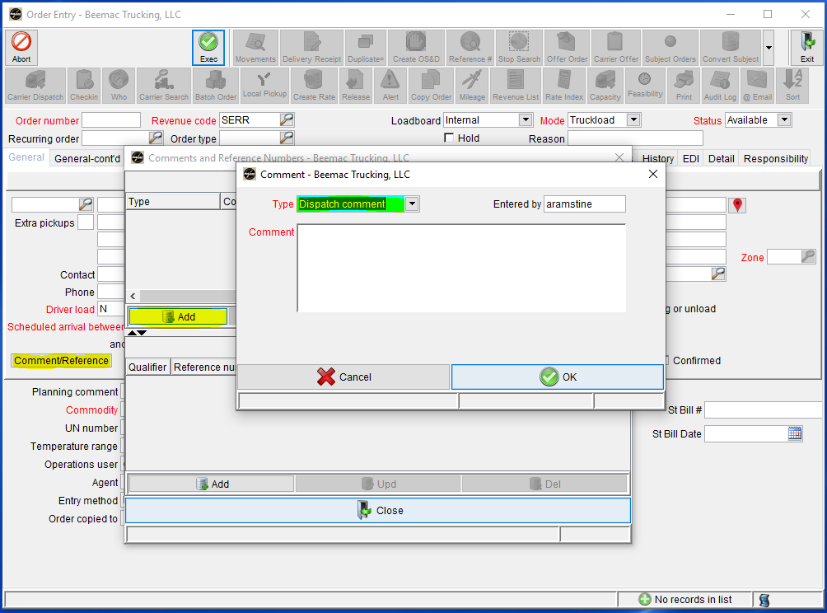
Enter a new ORDER – dispatch comments
After you are done entering information into the ‘General’ tab of your ‘Order Entry’ screen you will select the ‘Comments/References’ button under the Shipper address. You will get a pop-up window, select ‘Add’ and get another pop-up window.
In the pop-up window the ‘Type’ is ‘Dispatch comment’
In this screen you will enter any and all information that your driver will need to get loaded. You will enter any special information or directions as well as any numbers, commodity description, or special equipment the driver may need.
Please see the load building document printed for you for a general layout of how dispatch comments are to be built

Slide 10
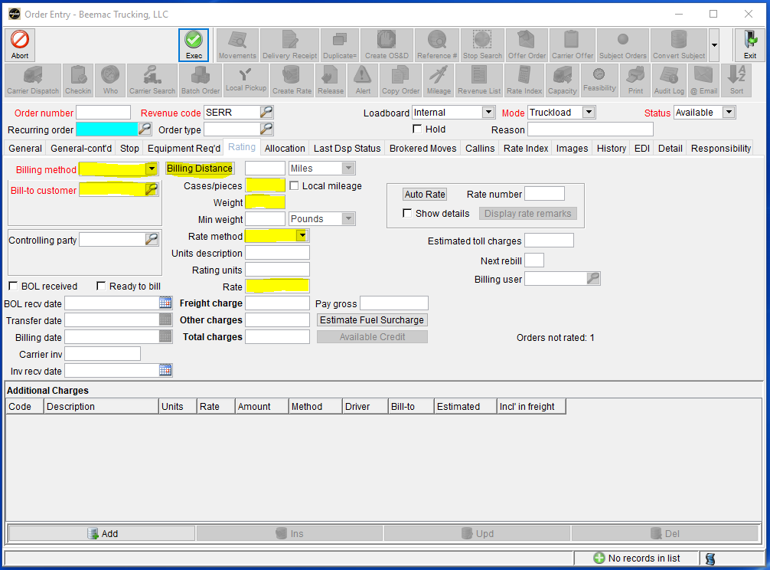
Enter a new ORDER – RATING TAB
Next you will fill out the customer and rating information in the ‘Rating’ tab.
First you will fill out the Billing Method. It is always ‘Third Party.’ Then select the magnifying glass and search the customer.
Select the ‘Billing Distance’ button. This will autogenerate your loaded miles. McLeod uses a program called PC Miler to get their miles. They will calculate from the center of the shipper zip code to the center of the consignee zip code. These are not address to address miles.

Slide 11
Enter a new ORDER – RATING TAB
If you know the piece count for you load you will enter it in the ‘Cases/pieces’ field. Under that you will enter the exact weight of this load. It is very important that you enter the load weight correctly.
Move to the ‘Rate Method’ drop down menu and select the method that your customer is paying by, usually it is a flat rate. However you can also rate by hundredth weight and distance.
Enter your shipper rate in the ‘Rate’ field. The shipper rate is the rate that the customer is paying you.

Slide 12
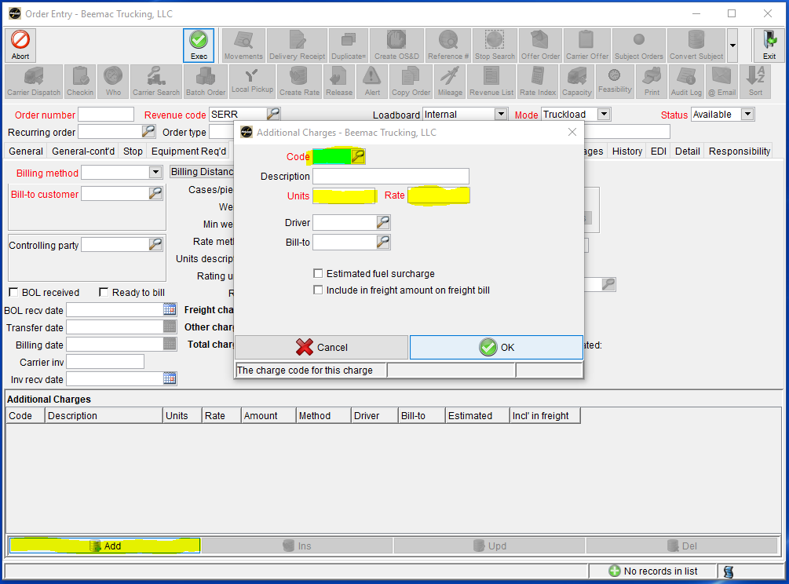
Enter a new ORDER – RATING TAB
Sometimes customers may break the cost of fuel out on a load in order to ensure that they are paying per market trend. When this happens you will go to the bottom of the screen and select the ‘Add’ button under ‘Additional Charges.’
You will get a pop-up. Select the magnifying glass and find a code that fits you needs, ensure the description is correct for your needs, enter the units, and then enter the rate.
Ex: If you are adding fuel and your customer pays fuel per mile you would use code FSD (fuel surcharge distance) then you would enter the number of miles in the units field and the rate per mile in the rate field.

Slide 13
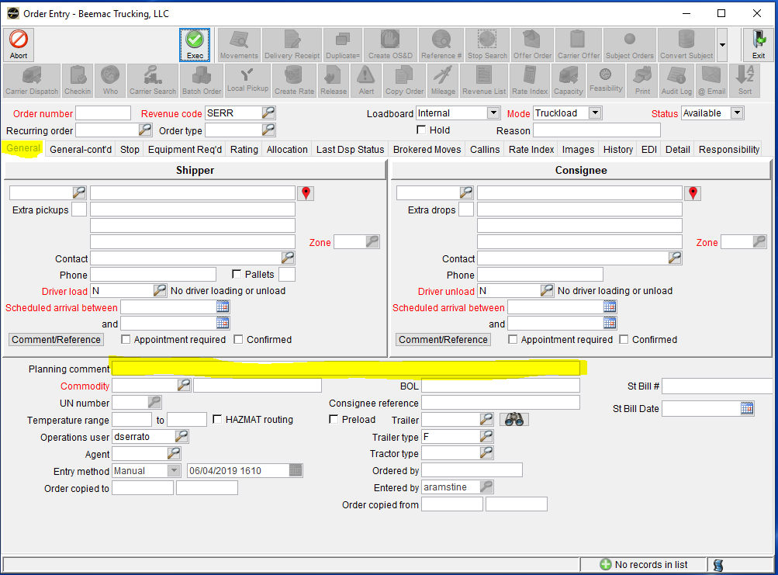
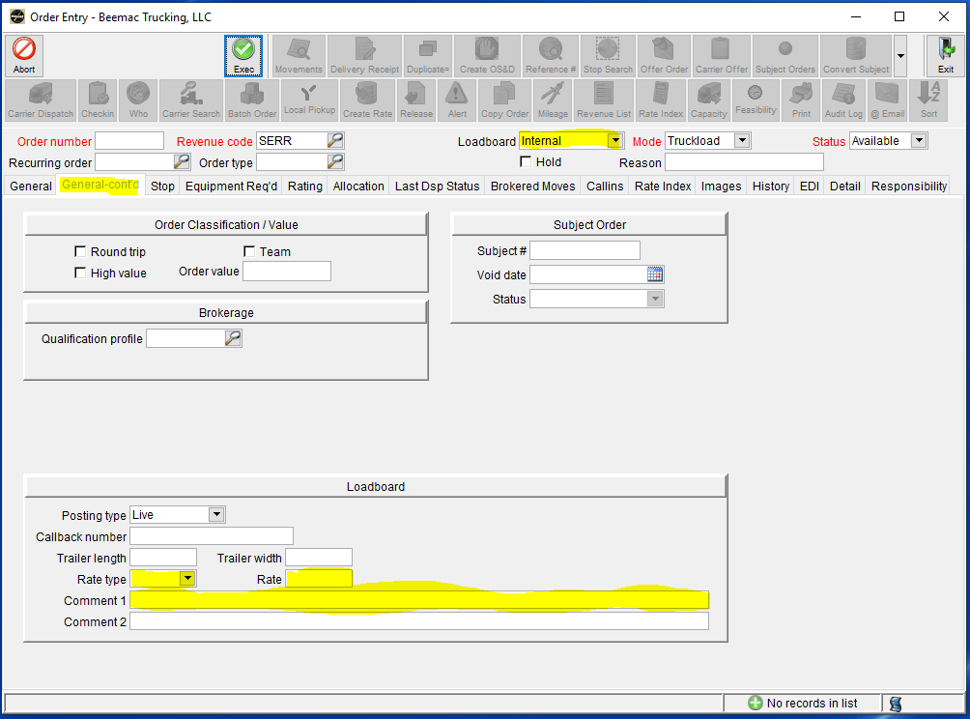
Enter a new ORDER – posting information
After you have built the load you will return to the ‘General’ tab. Here you will go to the ‘Planning comments’ field and enter a short, sellable description of the load.
Ex: 10K INSULATION, TWO 8FT TARPS, LOADS 7-5, DEL NEXT DAY@8A - $1298
Then go to the ‘General-cont’d’ tab. Here you will move the load from ‘internal’ to ‘loadboards.’ You will then get a box at the bottom of the screen with the loadboard information to enter. Enter the ‘Rate type’ as flat. Enter the carrier rate into the rate field and a small description in the ‘Comment 1’ field that you wan the driver to see on the load once it posts to the loadboards.

Slide 14
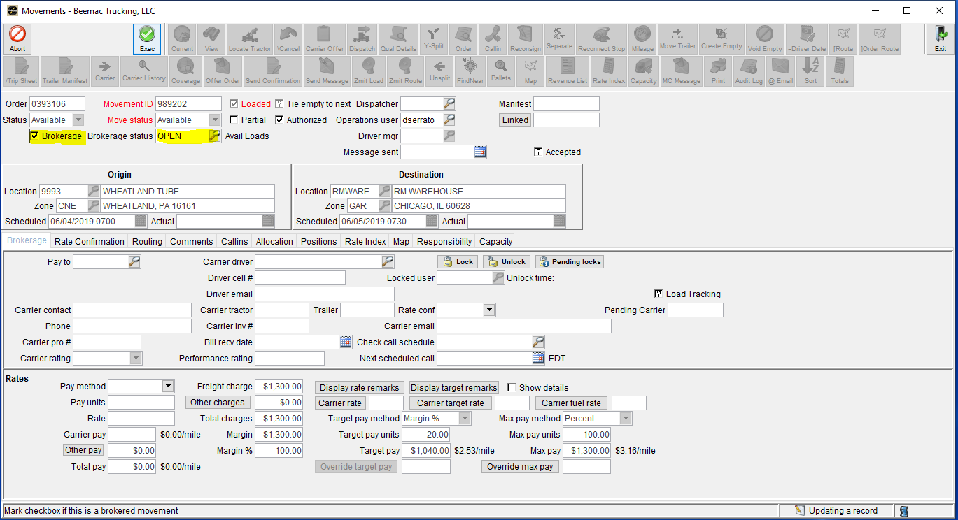
Enter a new ORDER – movements
Once you have completed the posting information you will select the ‘Exec’ button. This will populate an ‘Order number.’ Once you have your order number you will select the ‘Movements’ key at the top of the screen.
A new window will open. In the ‘Movements’ window you will check the brokerage box and this will change your ‘Brokerage status’ to OPEN. Select ‘Exec’ to save and exit the screen. This will change the load in the system so that it now shows up in the assigned Brokerage Planning.

Slide 15
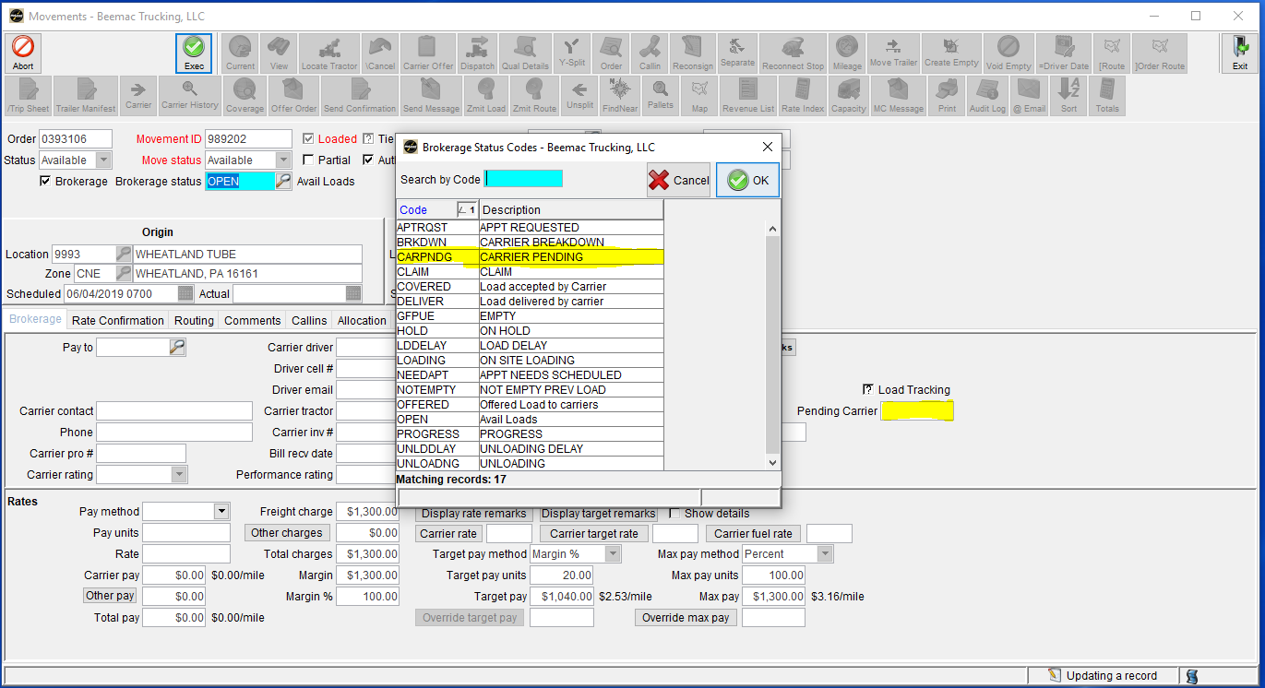
Enter a new ORDER – BROKERAGE STATUS
If you are building a load that is already covered you will change the ‘Brokerage status’ from ‘Open’ to ‘Carrier Pending.’ The ‘Carrier Pending’ status is used once you have covered a load and you are waiting for the driver to accept tracking or you are waiting for the carrier to be set up.
If you are waiting to set the carrier up you will put the load in ‘Carrier Pending’ status and then you will put the carrier’s MC in the ‘Pending Carrier’ field. This will send a report to our Carrier Management team notifying them that someone is waiting for a carrier to be set up.

