Slide 1
Systems training
Lifecycle of a load

Slide 2
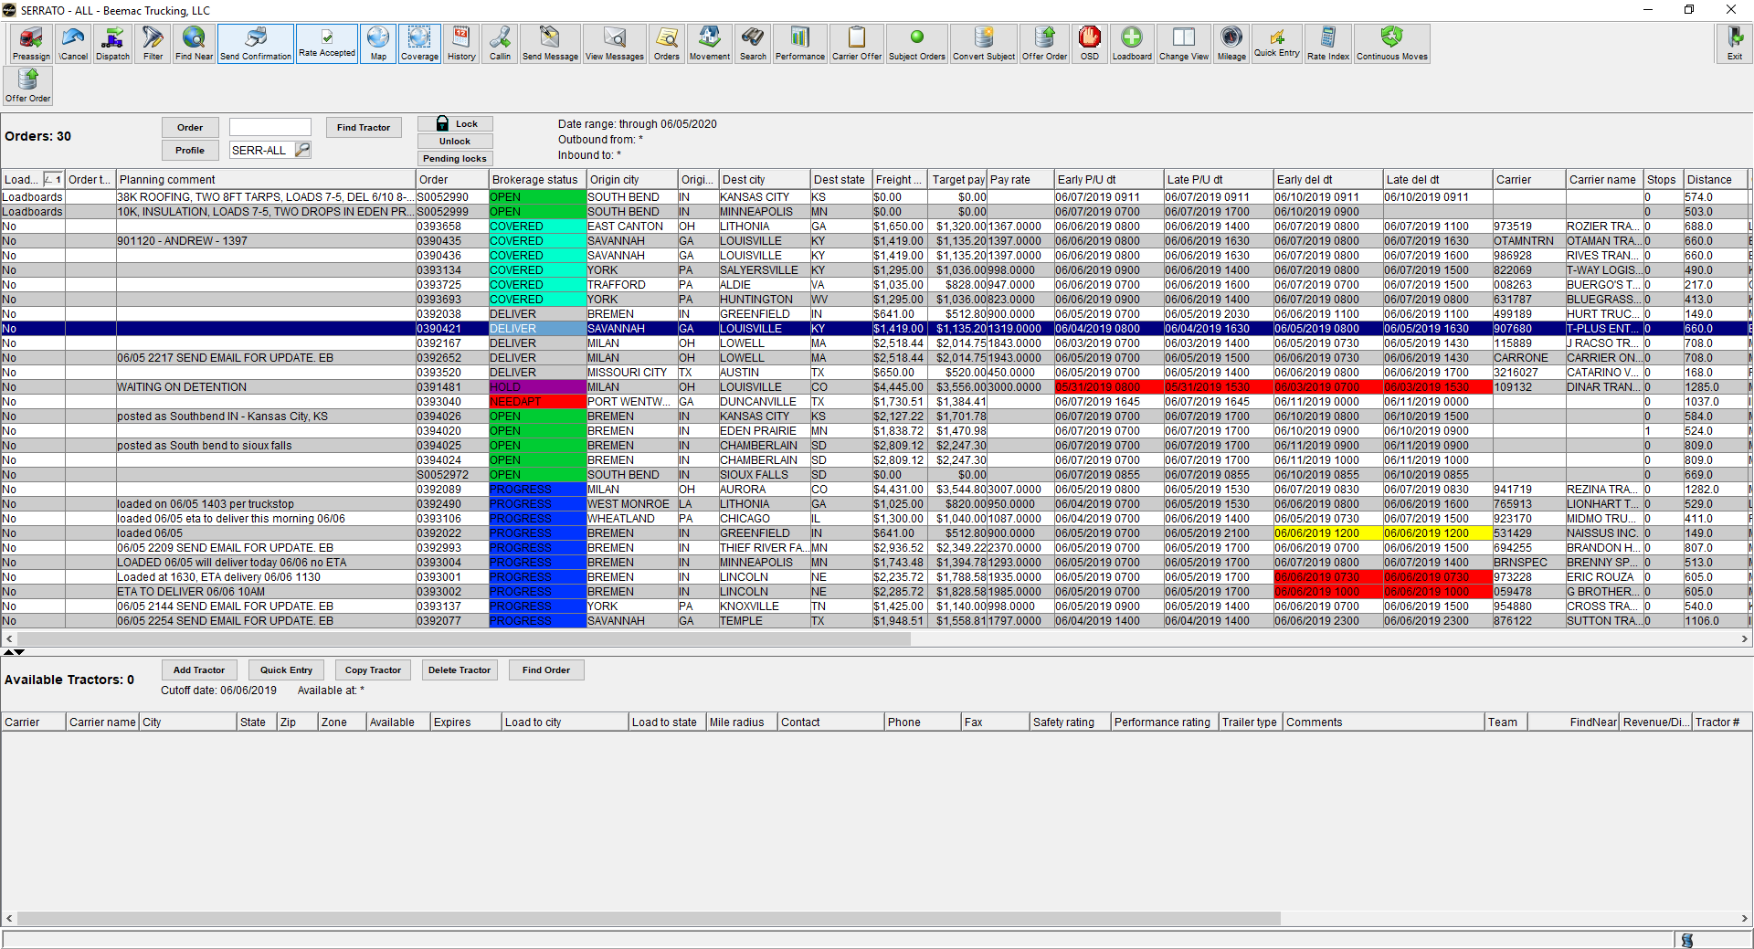
Brokerage planning
After a load has been built and put into brokerage planning you will then work on the load out of this screen. Brokerage planning is the most useful, versatile screen in McLeod. I recommend having this screen open at all times as we do everything off this screen.
In brokerage planning you will sell loads, cover loads, call out on trucks, search open freight, confirm pick-up and delivery, dispatch, and send rate confirmations. Every where you click on this screen opens a new pop-up that does something different.

Slide 3
You can click on any header to organize the loads.
Double clicking on the order number will open the order entry screen.
Double clicking on the Brokerage status will open the dispatch screen.
Double clicking on the pick-up or delivery city or state will open the movements screen
Double clicking on the carrier code or carrier name will open the carrier screen

Slide 4
posting
You can post and refresh posted loads through brokerage planning. When you build a load and switch the Loadboard status to ‘Loadboards’ the load will automatically post once it is executed. To refresh the load you will select the ‘Loadboards’ button at the top of the screen. This will pull the load down and change the loadboard status to ‘No.’ There is a 3-5 minute delay for refreshing.
If you want to bump the rate or make a change to the post you must first remove the post from the loadboard, make the changes, and then repost the load. You can take a post down and repost by clicking on the ‘Loadboard’ button.

Slide 5
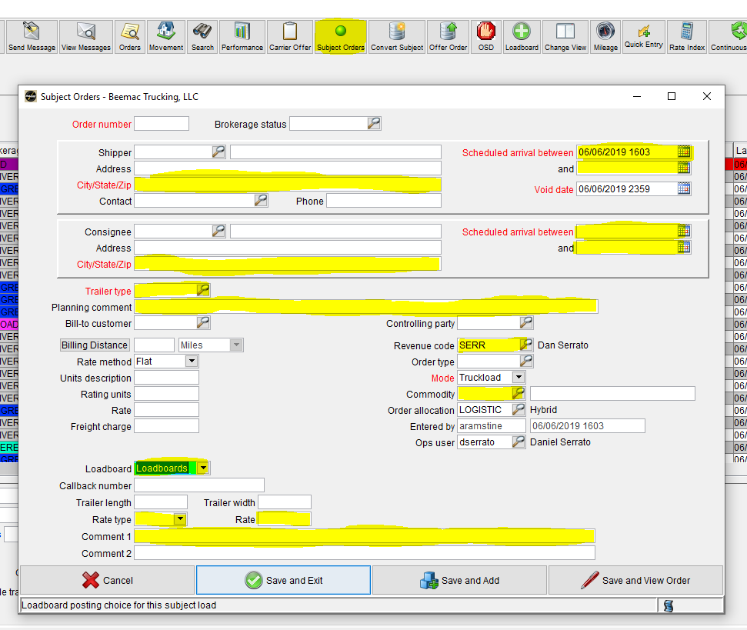
Posting – subject orders
To quickly post a load before it is built or to post a load out as different cities to get more views you will use the ‘Subject Orders’ button at the top of the brokerage planning screen. In this pop-up you will enter enough information to quickly post the load. At the top you will enter pickup and delivery city and state along with date and times. Beneath you need to enter the trailer type which you can select by the magnifying glass button.
In the planning comments you will put a brief, sellable description of the load.
Ex: 10K INSULATION, TWO 8FT TARPS, LOADS 7-5, DEL NEXT DAY@8A - $1298
Make sure the ‘Revenue Code’ field is correct and enter the commodity which you can select by the magnifying glass button.
Change the ‘Loadboards’ drop down to say loadboards. Change the ‘Rate type’ drop down to flat. Enter the rate and a small description in the ‘Comment 1’ field that you wan the driver to see on the load once it posts to the loadboards.

Slide 6
Search loads to sell in brokerage planning
When you are taking phone calls and a carrier calls in to book a load you have to search the load in Brokerage Planning to sell the load. First you will need to open the Brokerage Planning profile ‘ALL-OPEN’
You can search in this screen multiple ways. You can sort the freight via city and state and look for the load that way. You can ask the carrier for the reference number on the post. You will type that into the ‘Order’ field and hit enter.
You can also double click on the city title and type the name of the pick-up city in and the screen will automatically take you to all the loads loading out of this city.

Slide 7
Taking a call and selling a load
When taking a call to sell freight you will first ask the caller what lane they are calling on or what the reference number is on the post. After you have found the load in Brokerage planning you will read the notes in the planning comments field. If you double click on the planning comments field it will open the planning comments screen and you can read more or edit the comments.
Once you have read the planning comments to sell the load you may have to negotiate the posted rate. We do not sell freight in 5s & 0s. Rather then selling a load at 1400, you can sell it at 1387.
Once you have sold the load you must collect the carrier information. To do this you will need to open the carrier screen and also be logged into DAT carrier watch. The ‘Carriers’ button is on your LoadMaster.
DAT carrier watch - https://registry.dat.com/login.jsp
Account # 121072B1
Account holder: Mn
Password: 121072

Slide 8
Taking a call that is not for your team
When you are taking a call that is not to book a load and it’s not for your team there is certain information you must get and write down:
Caller name and number
Load number
Reason for calling
When you are taking a call that is to book a load for another team there is certain information you must get and write down:
Caller name and number
Lane
MC/DOT
Rate sold
ETA to pickup
Driver name and number

Slide 9
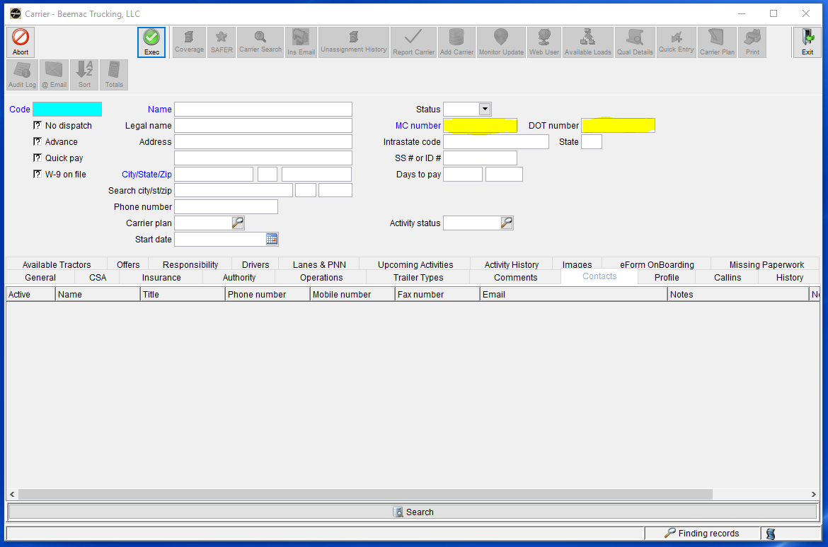
Booking a carrier and checking their information
To book a carrier you must follow these steps:
Get MC/DOT to search carrier
Check that the carrier is in good standing, we don’t need insurance or a new carrier packet.
To do this you will open the carrier screen and select the ‘Search’ button then enter the MC or DOT in the appropriate fields. Select execute and wait for information to populate if the carrier is set up or you will get an error stating the carrier is not set up.

Slide 10
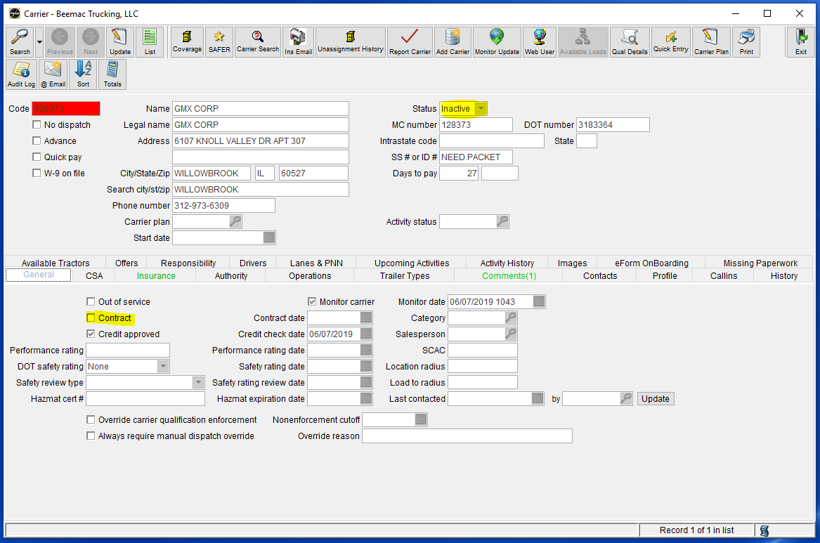
Booking a carrier and checking their information
If the carrier is set up in our system the carrier screen will auto generate with carrier information. First you want to verify that this is the correct carrier but the caller is from GMX Corp in Willowbrook, IL.
Next you want to ensure that they are in ‘Active Status’ and that the contract button is checked. You will also need to make sure the Insurance is up to date.
Once you have done that please read any and all comments to ensure this carrier is in good standing.

Slide 11
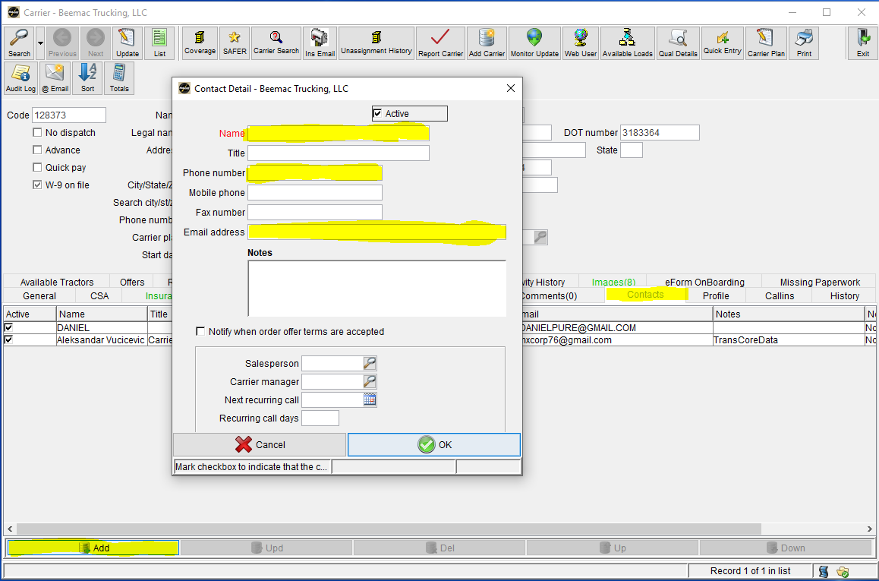
Booking a carrier and checking their information
Go to the contact tab and enter the dispatcher’s information.
Please get the name, phone number, and email of the person who is going to be updating the status of the load and getting the rate con. Often, drivers will call in and book their own loads and you will need to get their dispatchers information. This is a very important step to ensure that we can contact the right person throughout the life of a load.
After you have entered the dispatchers information added you can move your dispatcher to the top of the list by selecting their line and using the ‘Up’ key.

Slide 12
Booking a carrier and getting driver information
Once you have confirmed all the dispatchers information you are then required to get driver name and phone number. We track every single load via the Truckstop Mobile app. When you are booking a carrier on a load it is important that you explain to them that the driver must have a smart phone and must accept tracking before a rate con will be sent. No on is exempt from tracking. If they cannot/do not accept terms of tracking they cannot have the load.
Once you get the drivers name and phone number you write the following information down:
Lane
MC/DOT
Dispatch name & phone number
ETA to pickup
Driver name & phone number
Rate sold

Slide 13
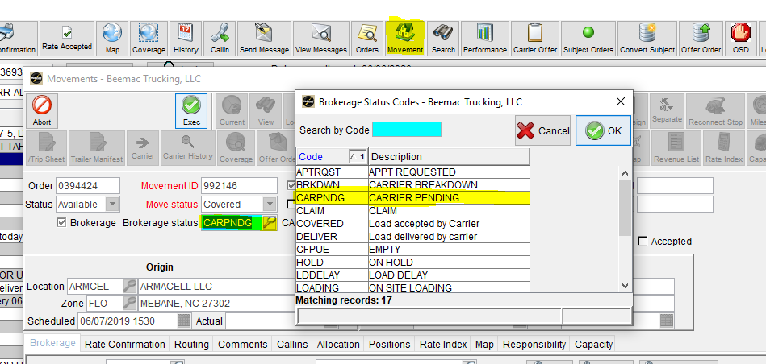
Booking a carrier and tracking drivers
After you have locked a carrier in you will pull the load down off the loadboard by selecting the green ‘Loadboards’ button which will switch the status to ‘No.’
After you pull the load down off the loadboard you will put the load in ‘Carrier Pending’ status by selecting the ‘Movements’ button at the top of the screen. Then select ‘Update’ and then select the ‘Brokerage status’ magnifying glass and select the status ‘Carrier Pending’ and execute.

Slide 14
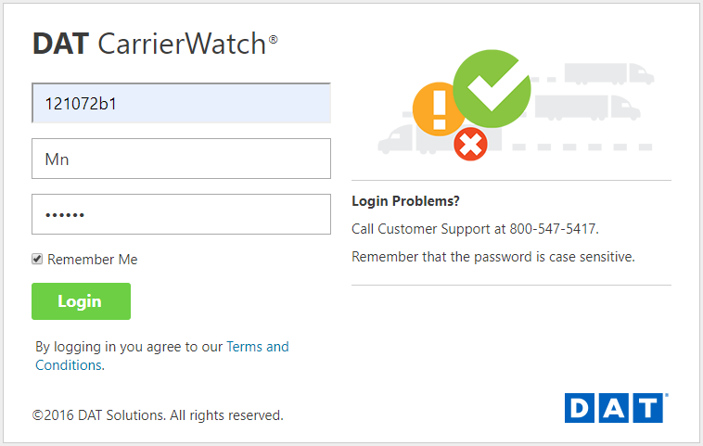
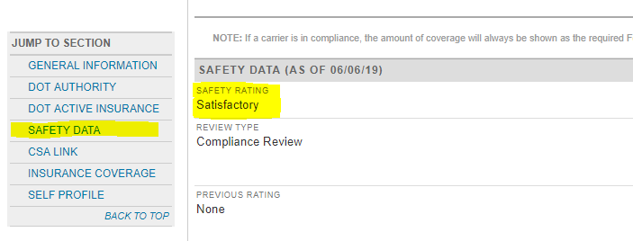
SETTING UP A NEW CARRIER
If the carrier’s information does not auto populate in the carrier screen you will need to set them up. Go to the DAT CarrierWatch website.
https://registry.dat.com/login.jsp
Account # 121072B1
Account holder: Mn
Password: 121072
Enter the DOT or MC in the search box. Select ‘GO’
MC – search by Docket#, DOT - search by DOT#
Check the safety rating by selecting the ‘SAFETY DATA’ menu on the left of the screen. We do not work with conditional carriers.
Check the carrier’s authority by clicking on the Docket number under the General Information menu. Open the report and scroll to the bottom and check their authority date. We have a six month policy.

Slide 15
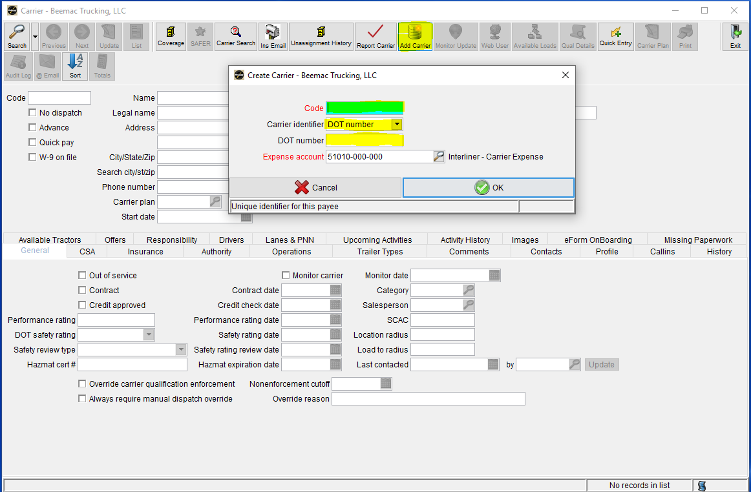
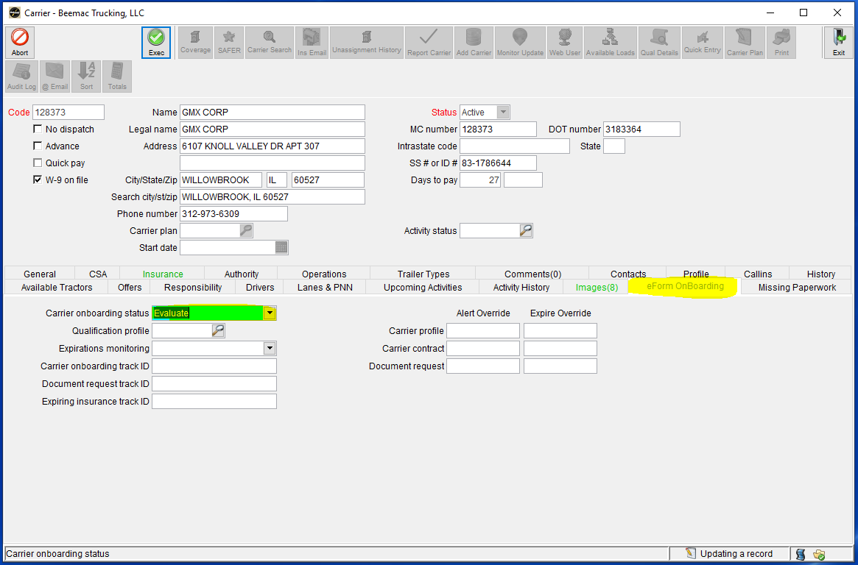
SETTING UP A NEW CARRIER
Once you have confirmed the carrier is elidable to be set up you will set them up in McLeod. Open the carrier screen and select the ‘Add’ button. This will prompt a pop up screen where you will enter the MC/DOT in the ‘Code’ field and then the corresponding ‘Carrier Identifier’ and then the DOT/MC again in the ‘DOT number’ field. Select ‘OK’ and this will prompt another pop-up screen with the carrier name. Verify this is the correct carrier and select ‘OK.’
Once the carrier screen auto populates with information confirm that it is correct. Add the dispatchers information. Open the ‘eForm OnBoarding’ tab in the middle of the screen. Change the ‘Carrier onboarding status’ field to ‘Evaluate’ and execute to send the carrier a set-up packet. If the carrier only has a DOT you must email them a carrier packet and CC the carrier management team with the DOT in the title.

Slide 16
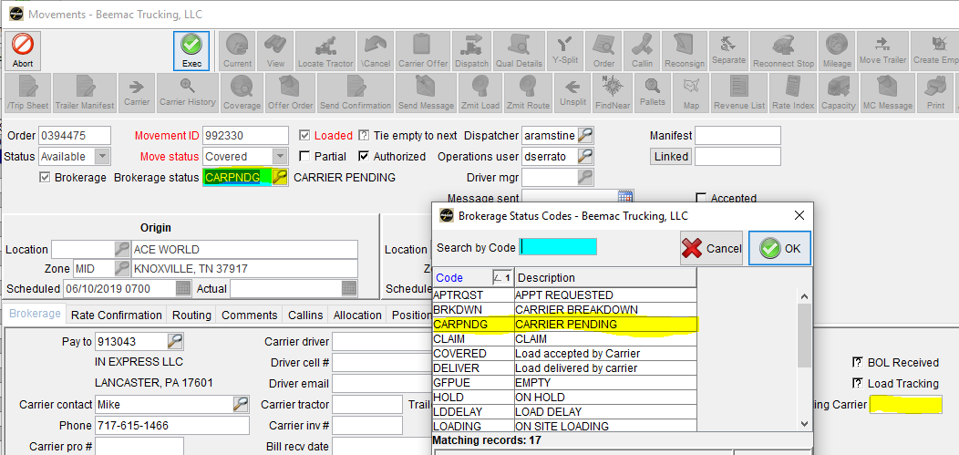
Booking a carrier and tracking drivers
After you have locked a carrier in and sent a set up packet you will pull the load down off the loadboard by selecting the green ‘Loadboards’ button which will switch the status to ‘No.’
After you pull the load down off the loadboard you will put the load in ‘Carrier Pending’ status by selecting the ‘Movements’ button at the top of the screen. Then select ‘Update’ and then select the ‘Brokerage status’ magnifying glass and select the status ‘Carrier Pending’ and put the carrier MC/DOT in the ‘Pending Carrier’ field. This will send a report to the Carrier Management team that carrier setup is needed.

Slide 17
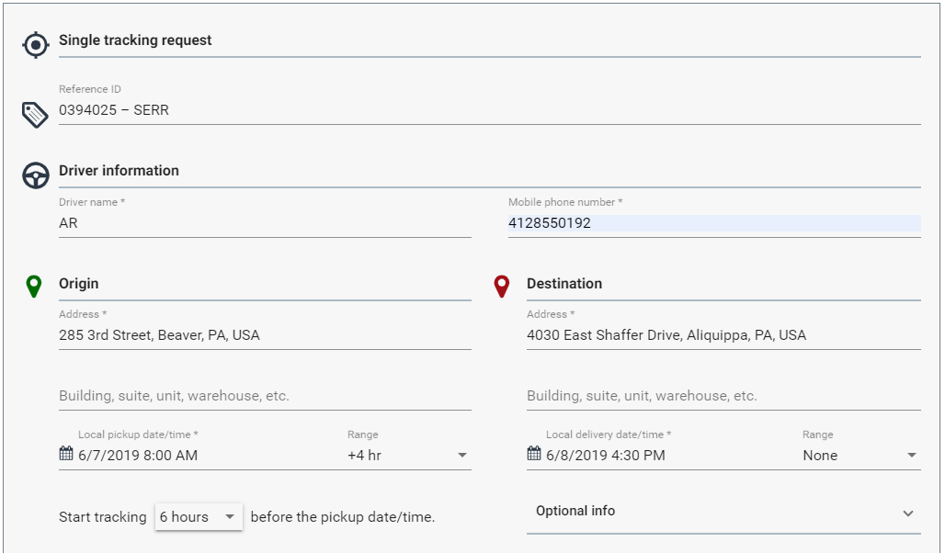
Sending truckstop tracking
Log into the Truckstop tracking account – https://loadtracking.truckstop.com
Email: tracking@Beemac.com Password: loadtracking
Open ‘New Track’ tab.
The ‘Reference ID’ field is going to be the Beemac Order number – Revenue Code.
Ex: 0394025 – SERR
Enter driver name and phone number
Enter the pickup and delivery address as you have them entered in McLeod
Enter pickup/delivery date and time
Ex: 6/10/2019 8:00AM +4 hr (8-12 FCFS)
Ex: 6/11/2019 8:00AM None (8am by appt)

Slide 18
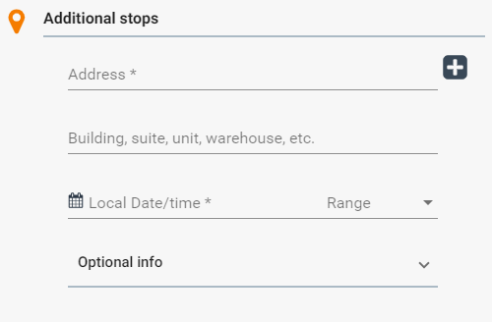
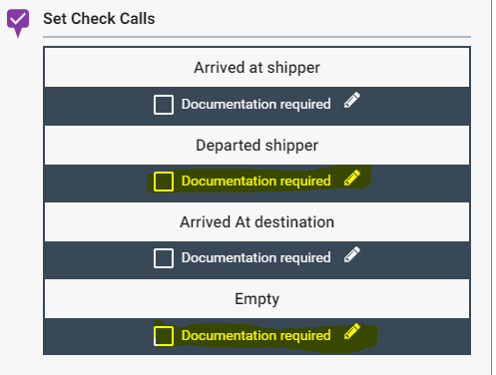
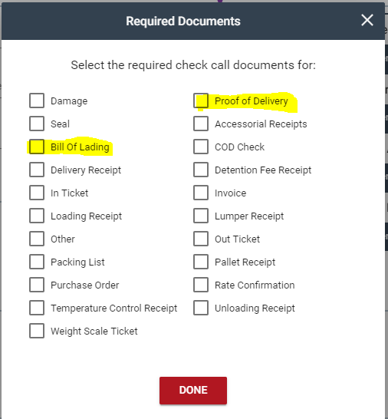
Sending truckstop tracking
To add more than one pick-up or delivery you can do so under ‘Additional stops’ and press the plus sign button
To request the BOL at pick-up and the POD at delivery you will select the documentation required pen and get a pop-up
Check the Bill of Lading for the departed shipper document
Check the Proof of Delivery for the Empty document

Slide 19
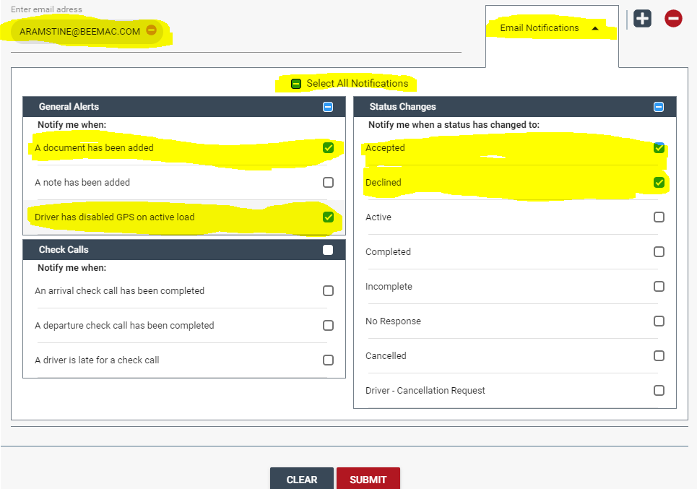
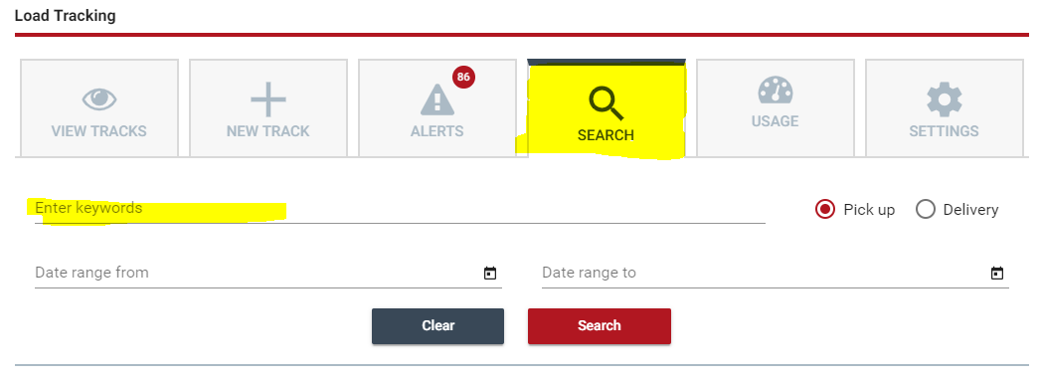
Sending truckstop tracking
Enter your email
Select ‘Email Notifications’
De-select all Notifications
Check boxes for:
Accepted
Declined
A document has been added
Driver has disabled GPS on active load
Select submit
You will get an email when the driver has accepted the tracking. If the dispatcher calls and says the driver accepted the tracking and you did not get an email you can search the load by opening the ‘Search” tab and typing the Beemac order number in the search field.

Slide 20
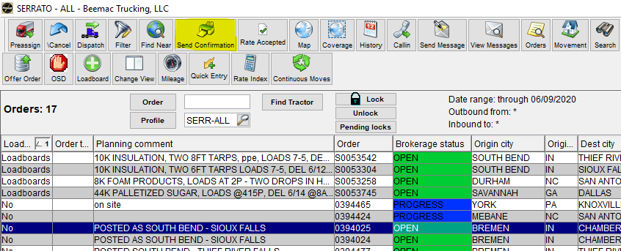
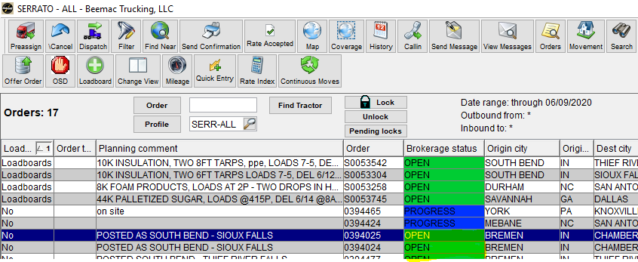
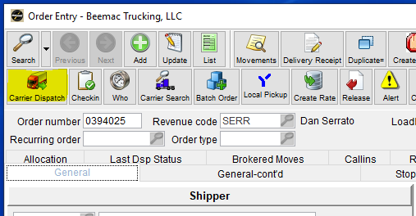
Sending a rate confirmation
After tracking is accepted a rate confirmation can be sent.
You can do this four ways:
in Brokerage planning using the ‘Send Confirmation’ button
By double clicking on the ‘Brokerage Status’ of a load
By opening the load in order entry and selecting the ‘Carrier Dispatch’ button.
By clicking on the ‘Dispatch’ button in Brokerage Planning

Slide 21
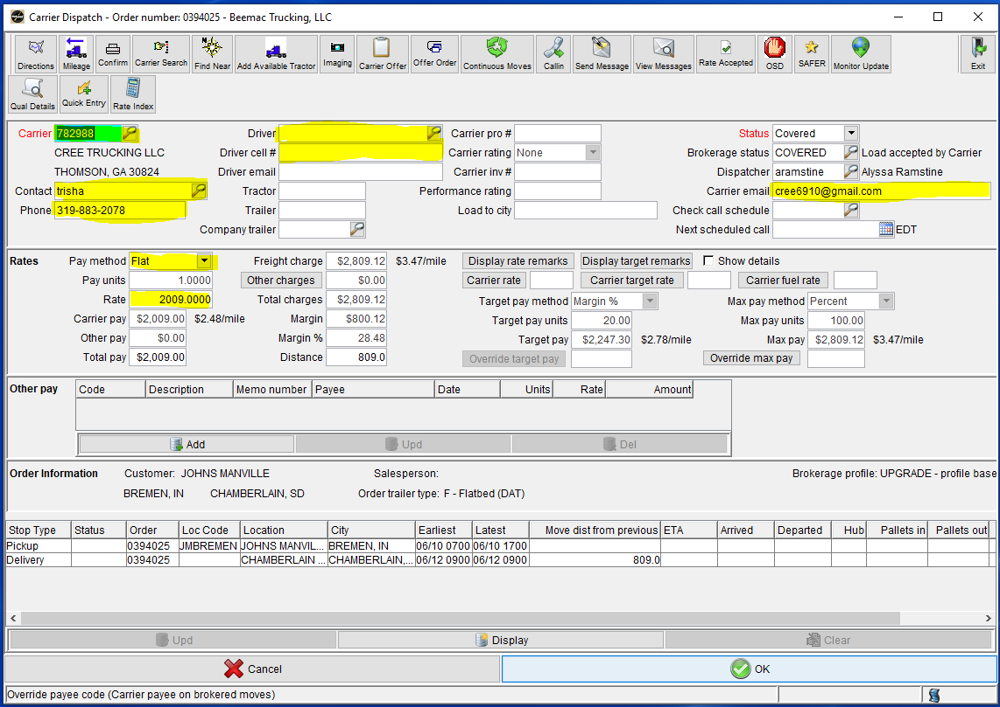
Sending a rate confirmation
Any one of those ways will take you to the dispatch screen. In the dispatch screen you will enter the carrier code in the ‘Carrier’ field. This can be there MC/DOT number or different code depending on who sent them up. If their MC/DOT doe not pull up the carrier you can also search by carrier name by clicking on the magnifying glass. Next you will verify the dispatch name, number, and email. You can change to a different dispatcher in the system by clicking on the magnifying glass.
Under the ‘Rates’ section you will select ‘Flat’ under Pay Method and then enter the carrier rate in the ‘Rate’ field.
You will also enter the Driver name and phone number in this screen.

Slide 22
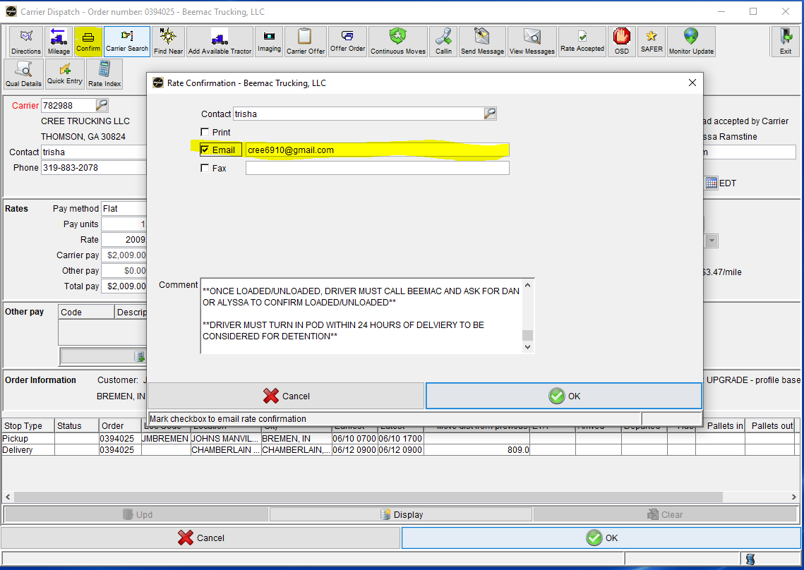
Sending a rate confirmation
After you have entered and verified all your information you will select the ‘Confirm’ button at the top of the screen. This will prompt a pop-up for the way in which the rate con is sent. De-select the ‘Print’ field and select ‘Email.’
Select ‘OK’ at the bottom of the screen and this will open an email. Always, thank them for their business and CC the appropriate people.
This changes the load status to ‘COVERED’

Slide 23
Tracking a load
Once a load has been dispatched to a carrier the tracking process must start. The first step in the tracking process is to receive acknowledgment of the rate confirmation. Either via email or a signed rate confirmation (preferred but not required.)
We have a team dedicated to tracking the pick-up and delivery of this load. This team is only to track pickups and deliveries. They will utilize the Truckstop Tracking tool as well as calling and emailing the carrier. Please remember, though we have this team ultimately the confirmation of pickups and deliveries is your responsibility. If you receive a call or an email for confirmation of pickup or delivery you will send an email to tracking@Beemac.com with the order number in the subject and in the body explain picked up or delivered and they will push it through the system. The tracking team will use several different load status throughout the life of the load. These are the most common:
Loading – confirmed driver is on-site to load
Progress – confirmed driver is loaded and rolling
Unloading – confirmed driver is on-site to delivery
Delivered – confirmed driver is unloaded and load has clean POD
There are other status that may pop up as well. Please see Beemac Logistics Load Status Workflow for more information.

Slide 24
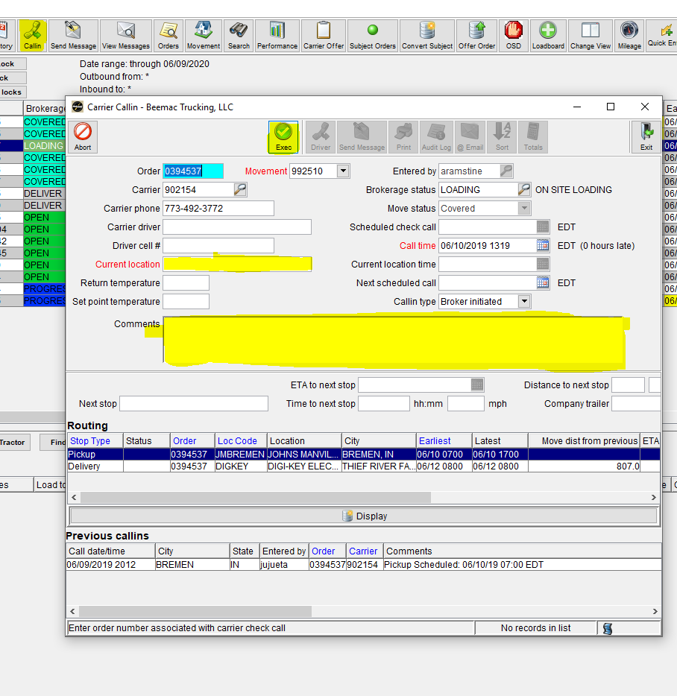
CALL-IN
Should a carrier call in with an update on location you will enter that into the “Callin’ button at the top of the Brokerage Planning screen. This will open a pop-up that will prompt you to enter the carrier location in the ‘Current Location’ field.
You can also enter notes in this screen. Any and all carrier contact should be documented on this screen. This prevents us from contacting a carrier over and over again. If the carrier does not answer the phone you still need to note it in the ‘Callin’ screen.
You can open this screen and see when the tracking team has last contacted a carrier.

