Slide 1
Searching For Trucks Through McLeod (Using History & Loadboards)

Slide 2
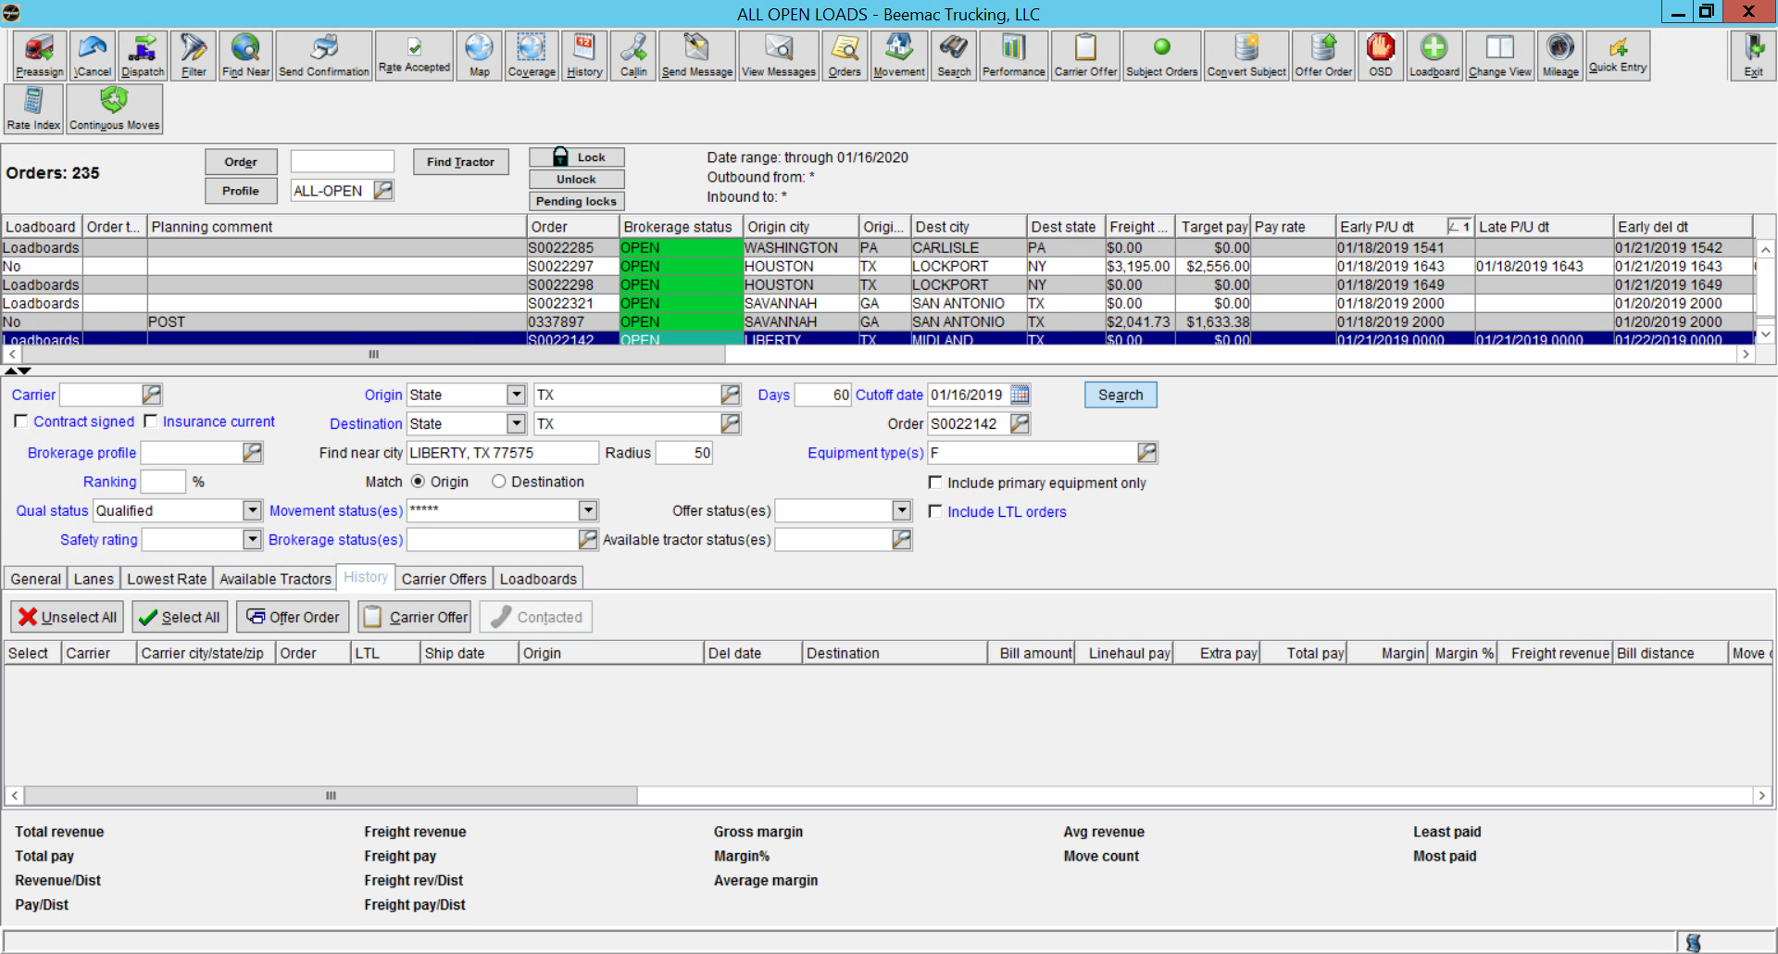
From Brokerage planning, highlight the load you are working on.

Slide 3
In the bottom section, make sure that the History tab is selected

Slide 4
Select the search radius desired. It will default to 50 miles.
Once completed, click Search

Slide 5
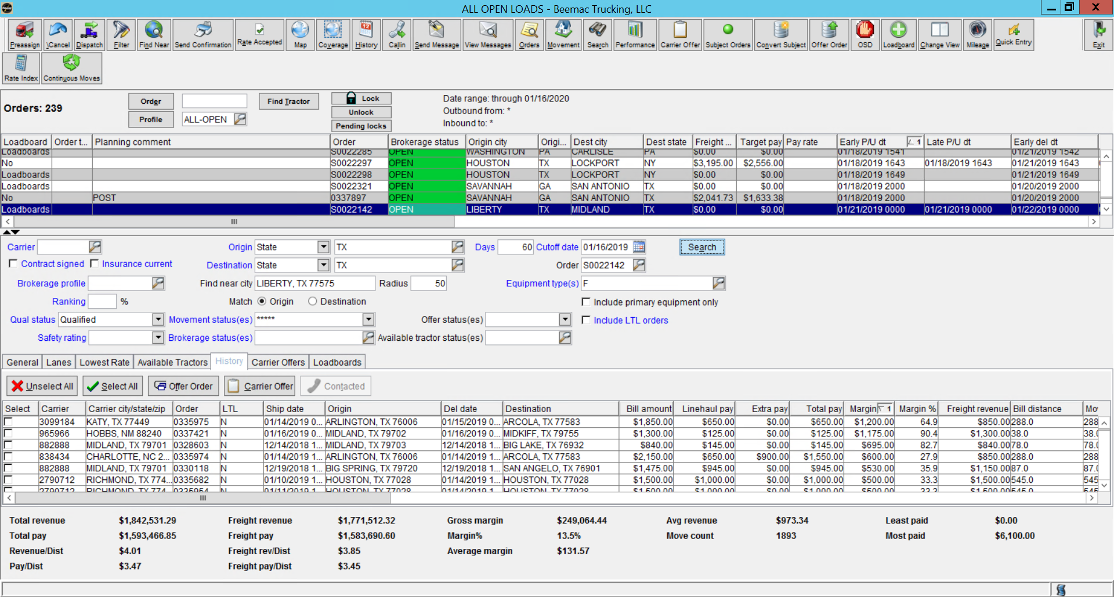
Below are the available trucks that meet the search criteria selected
You are able to sort by any of the tabs

Slide 6
Go through the list of trucks and call out on the ones that make the most sense based on the search criteria
Use your negotiation skills to find a truck at the best rate without sacrificing service.
Happy Truck Hunting!!!

Slide 7
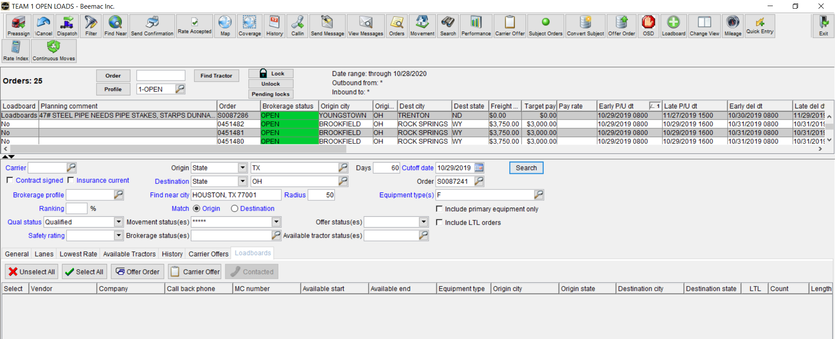
Searching Trucks From the Loadboards
- From Brokerage Planning, highlight the load you want to find trucks for. Make sure the Loadboards tab is selected below and click search.

Slide 8
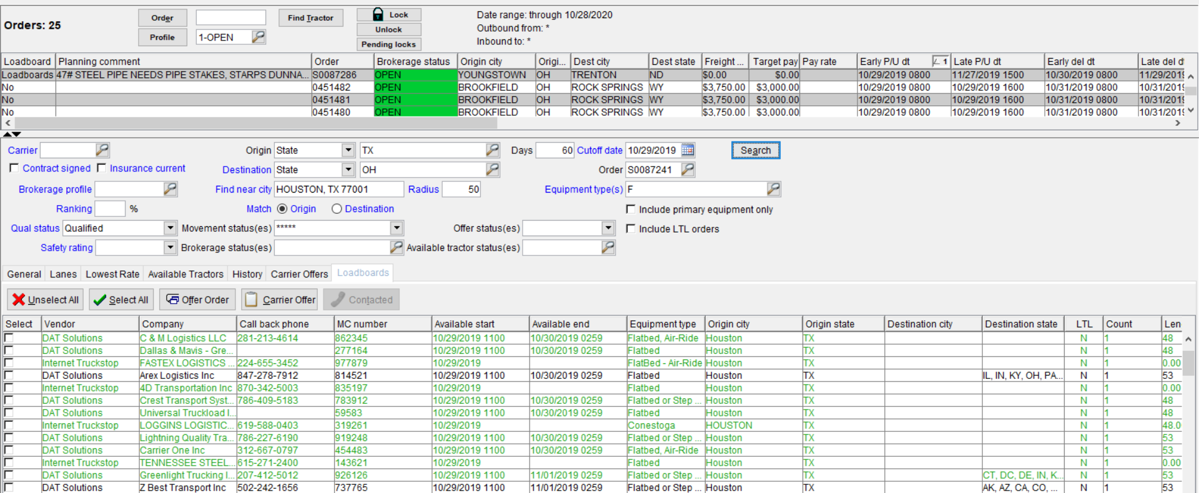
Searching Trucks From the Loadboards
- Results will populate below. If highlighted green, the carrier is already set up with Beemac. If black, carrier is not active with Beemac. Columns can be sorted by or configured as desired.
Happy Truck Hunting!!!

